Slide 1
Woomera Accelerating access to VoIP
Cluecon 2009, 7 August 2009
Craig Southeren

Slide 2
Introduction
Co-founder of OpenH323 project
Co-maintainer of Opal project
Post Increment
Consulting
Contracting
Open source development

Slide 3
What problems are we trying to solve?

Slide 4
Business Problems
Create complex VoIP systems
Remote customers
Division of labour
Blame game
Scalability, redundancy, availability
Minimise duplicated code
Different programming languages

Slide 5
Mix closed source and open source software, and incompatible open source licenses

Slide 6
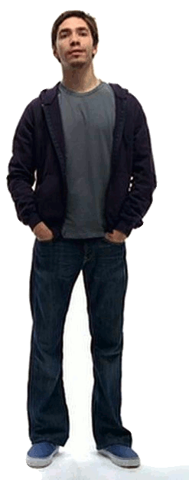
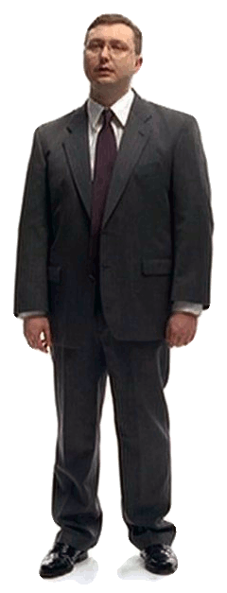
Different operating systems in the same product

Slide 7
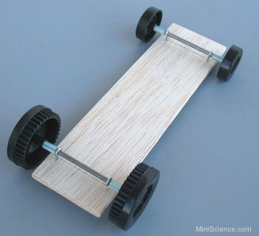
We want simple and easy

Slide 8
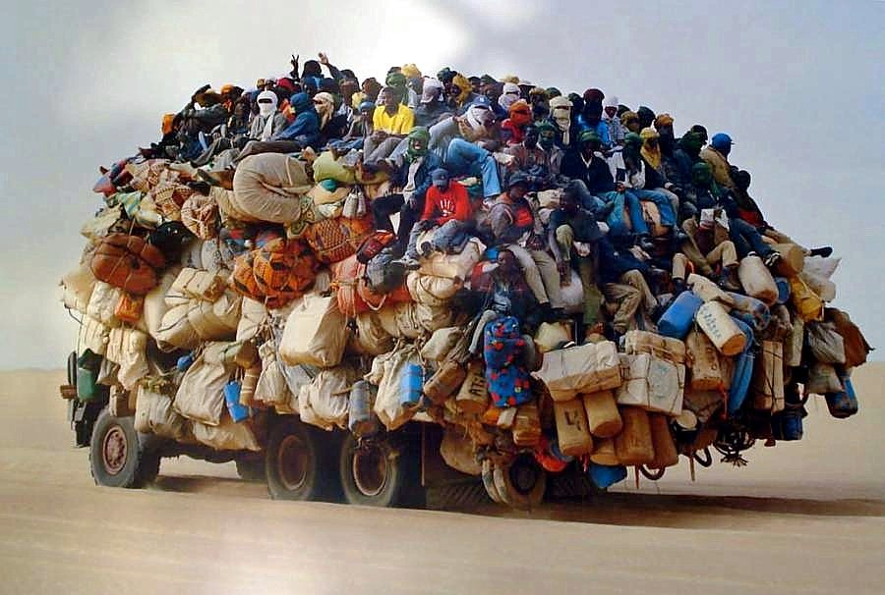
We don’t want lots of baggage

Slide 9
The solution
Socket-based protocol
Like HTTP or SMTP
Client-server architecture
Commands to make/hangup/answer calls
Not as complex as SIP!
TCP socket for multiple calls
MPL/GPL license

Slide 10
Woomera
Overriding principle: KISS
Use sockets to connect components
Text based protocol, not an API
Server/client architecture
Command/response for actions
Events for status changes
Not reinvention of SIP/MGCP/H.323

Slide 11
One to one
Driver abstraction
Application
Woomera Server
Client
Server
Woomera
VoIP protocol

Slide 12
Many to one
Application redundancy
Application
Woomera Server
Client
Server
Woomera
Application
Client
VoIP protocol

Slide 13
One to many
Load balancing
Application
Woomera Server
VoIP protocol
Client
Server
Woomera
Woomera Server
VoIP protocol
Server

Slide 14
Many to many
Full redundancy
Application
Woomera Server
VoIP protocol
Client
Server
Woomera
Application
Woomera Server
VoIP protocol
Client
Server

Slide 15
Message flow
Client sends command, server responds
Server can send events at any time
No overlapped commands/responses
Use of multiple sockets encouraged
TCP socket for commands
UDP socket for media
Extensible

Slide 16
Message format
Same as SIP/HTTP/SMTP
command + args
MIME information
<empty line>
Optional body
Event
EVENT INCOMING
Unique-Call-Id: 20000000
Protocol: sip
<empty line>

Slide 17
Command and media
Commands sent over TCP
Audio media sent over UDP
PCM-16 / SLINEAR
uLaw/ALaw
Audio can flow direct
Audio can be proxied
cmds
Client
cmds
Server
Server
media
cmds
Client
cmds
Server
Server
media
media

Slide 18
Outgoing call
Client
Server

Slide 19
Outgoing call
Client
Server
CALL sip:time@opalvoip.net
Raw-Audio: 12.3.4.5:1000
<empty line>

Slide 20
Outgoing call
Client
Server
CALL sip:time@opalvoip.net
Raw-Audio: 12.3.4.5:1000
<empty line>
200 Call started
Unique-Call-Id: 10000000
<empty line>

Slide 21
Outgoing call
Client
Server
CALL sip:time@opalvoip.net
Raw-Audio: 12.3.4.5:1000
<empty line>
200 Call started
Unique-Call-Id: 10000000
<empty line>
EVENT PROCEEDING
Unique-Call-Id: 10000000
<empty line>

Slide 22
Outgoing call
Client
Server
CALL sip:time@opalvoip.net
Raw-Audio: 12.3.4.5:1000
<empty line>
200 Call started
Unique-Call-Id: 10000000
<empty line>
EVENT PROCEEDING
Unique-Call-Id: 10000000
<empty line>
EVENT CONNECT
Unique-Call-Id: 10000000
Raw-Audio: 67.8.9.1
<empty line>

Slide 23
Incoming call (part 1)
Client
Server

Slide 24
Incoming call (part 1)
Client
Server
LISTEN
<empty line>

Slide 25
Incoming call (part 1)
Client
Server
LISTEN
<empty line>
200 Listen accepted
<empty line>

Slide 26
Incoming call (part 1)
Client
Server
LISTEN
<empty line>
200 Listen accepted
<empty line>
..... some time later .....

Slide 27
Incoming call (part 1)
Client
Server
LISTEN
<empty line>
200 Listen accepted
<empty line>
..... some time later .....
EVENT INCOMING
Unique-Call-Id: 10000000
Local-Number: 1234
Remote-Number: 5678
Protocol: sip
<empty line>

Slide 28
Incoming call (part 2)
Client
Server

Slide 29
Incoming call (part 2)
Client
Server
ACCEPT
Unique-Call-Id: 10000000
Raw-Audio: 12.3.4.5:1000
<empty line>

Slide 30
Incoming call (part 2)
Client
Server
ACCEPT
Unique-Call-Id: 10000000
Raw-Audio: 12.3.4.5:1000
<empty line>
200 Call accepted
Unique-Call-Id: 10000000
Raw-Audio: 67.8.9.1
<empty line>

Slide 31
Incoming call (part 2)
Client
Server
ACCEPT
Unique-Call-Id: 10000000
Raw-Audio: 12.3.4.5:1000
<empty line>
200 Call accepted
Unique-Call-Id: 10000000
Raw-Audio: 67.8.9.1
<empty line>
ANSWER
Unique-Call-Id: 10000000
<empty line>

Slide 32
Incoming call (part 2)
Client
Server
ACCEPT
Unique-Call-Id: 10000000
Raw-Audio: 12.3.4.5:1000
<empty line>
200 Call accepted
Unique-Call-Id: 10000000
Raw-Audio: 67.8.9.1
<empty line>
ANSWER
Unique-Call-Id: 10000000
<empty line>
200 Call answered
Unique-Call-Id: 10000000
<empty line>

Slide 33
Local call hangup
Client
Server

Slide 34
Local call hangup
Client
Server
HANGUP
Unique-Call-Id: 10000000
<empty line>

Slide 35
Local call hangup
Client
Server
HANGUP
Unique-Call-Id: 10000000
<empty line>
200 Call hungup
Unique-Call-Id: 10000000
<empty line>

Slide 36
Remote call hangup
Client
Server

Slide 37
Remote call hangup
Client
Server
EVENT HANGUP
Unique-Call-Id: 10000000
<empty line>

Slide 38
Remote call hangup
Client
Server
EVENT HANGUP
Unique-Call-Id: 10000000
<empty line>
HANGUP
Unique-Call-Id: 10000000
<empty line>

Slide 39
Remote call hangup
Client
Server
EVENT HANGUP
Unique-Call-Id: 10000000
<empty line>
HANGUP
Unique-Call-Id: 10000000
<empty line>
200 Call hungup
Unique-Call-Id: 10000000
<empty line>

Slide 40
DTMF
Client
Server

Slide 41
DTMF
Client
Server
DTMF
Unique-Call-Id: 10000000
Content-Length: 11
<empty line>
14157773456

Slide 42
DTMF
Client
Server
DTMF
Unique-Call-Id: 10000000
Content-Length: 11
<empty line>
14157773456
200 DTMF accepted
Unique-Call-Id: 10000000
<empty line>

Slide 43
DTMF
Client
Server
DTMF
Unique-Call-Id: 10000000
Content-Length: 11
<empty line>
14157773456
200 DTMF accepted
Unique-Call-Id: 10000000
<empty line>
EVENT DTMF
Unique-Call-Id: 10000000
Content-Length: 11
<empty line>
14157773456

Slide 44
H.323 and Woomera
Command
Event
H.323 PDU
CALL
H.225 SETUP
PROCEEDING
H.225 PROCEEDING
CONNECT
H.225 CONNECT
INCOMING
H.225 SETUP
ACCEPT
H.225 ALERTING
ANSWER
H.225 CONNECT
HANGUP
H.225 RELEASE COMPLETE
H.225 RELEASE
COMPLETE
HANGUP
DTMF
H.245 UI/RFC 2833
DTMF
H.245 UI/RFC 2833

Slide 45
SIP and Woomera
Command
Event
SIP PDU
CALL
INVITE
PROCEEDING
180 Ringing
CONNECT
200 OK
INCOMING
INVITE
ACCEPT
180 RINGING
ANSWER
200 OK
HANGUP
HANGUP
HANGUP
HANGUP
DTMF
INFO/RFC 2833
DTMF
INFO/RFC 2833

Slide 46
Real-world example #1
H.323 for Asterisk
Asterisk
chan_woomera
Woomera
WoomeraOpal
H.323

Slide 47
Real-world example #2
Audio-conferencing for collaboration
Jabber-based collaboration server
CLI
Jabber
WOpenMCU
Jabber clients (2000+)
Woomera
Woomera
WoomeraRTP
WoomeraOpal
RTP

Slide 48
Real-world example #3
Multi-protocol router
Incoming leg
Outbound leg
Woomera
WoomeraOpal
SIP, H.323 etc
SIP, H.323 etc

Slide 49
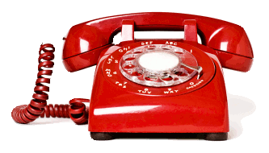
Real-world example #4
Dealer trading room system
Control software
CLI
WOpenMCU
Woomera
SIP handsets
WoomeraOpal
SIP gateway

Slide 50
Libwoomera
“C” interface
Single threaded
Triple license : GPL/LGPL/MPL
Server and client
Windows and Unix
Self-proxy
Auto-discovery of servers

Slide 51
Clients
WOpenMCU – audio MCU
Wproxy – back to back proxy
chan_woomera – asterisk channel
Sangoma Media Gateway

Slide 52
Servers
WoomeraOPAL – SIP, H.323, IAX, ivr, fax
WoomeraRTP – raw RTP and SRTP
WoomeraPRI – E1/T1 over Sangoma PRI
Sangoma – BRI and SS7

Slide 53
Future work
Draft RFC
Video support
Hold and transfer
Server limits and soft shutdown
Secure command channel
Secure media
Different raw media types
Call bridging
Libwoomera enhancements

Slide 54
Questions ?
craigs@postincrement.com
http://www.woomeravoip.org

