Slide 1


Building A Telephony Application With FreeSWITCH and Lua:
Employee Time Clock
William Dale, PE - Cluecon 2009 – www.labortimetracker.com

Slide 2
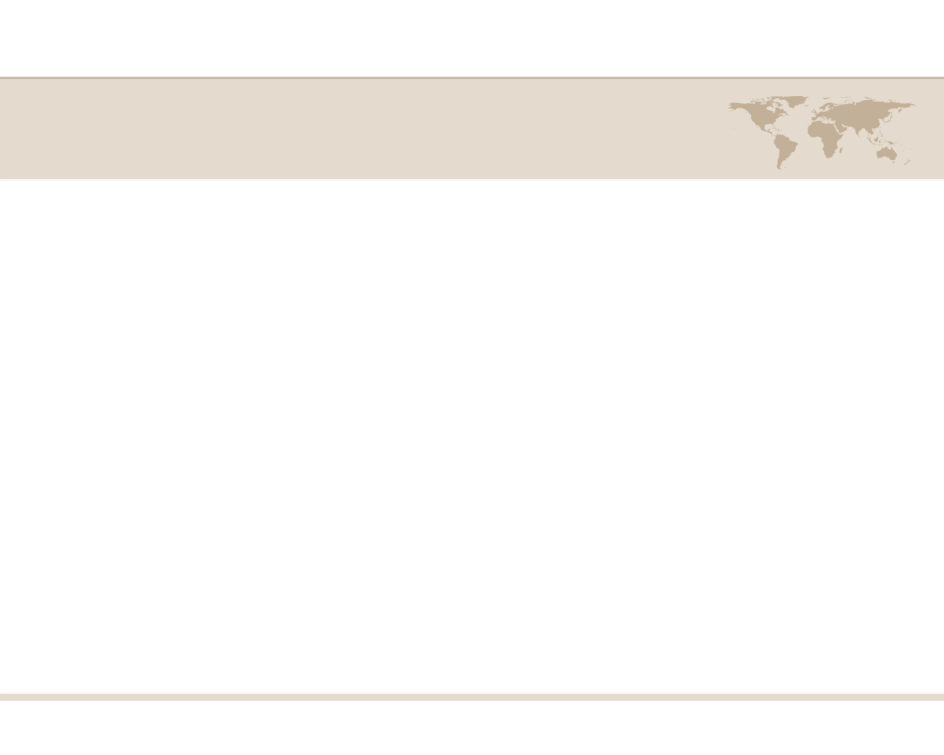
Architecture Overview
PSTN
Gateway
(Inbound Phone Call)
Com Server (FreeSWITCH)
✓ Dial Plan
Lua Script
Mod_CURL
PSTN Gateway
COM Server
Application Server
Database Server
Database
Exec
Stored Procedure
Web Service
Querystring Parameter
(HTTP Get)
William Dale, PE - Cluecon 2009 – www.labortimetracker.com
Notes:
Overview

Slide 3
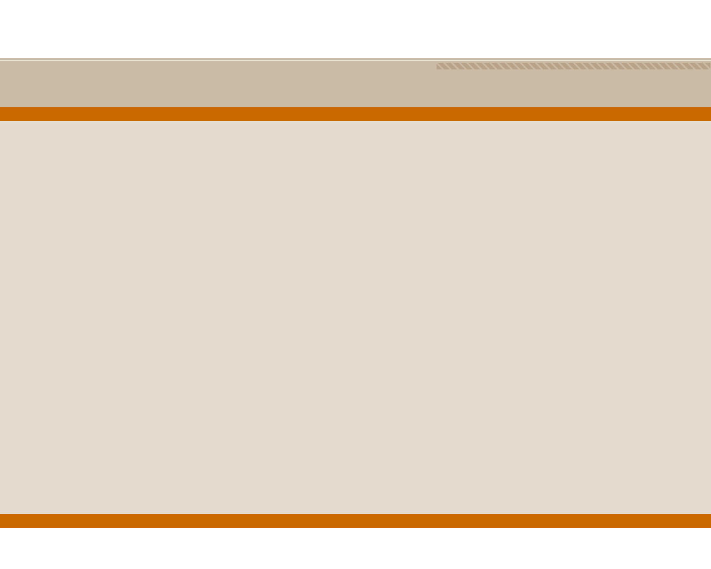
Route Phone Call to FreeSWITCH
Contract with PSTN Provider
SIP Trunk
Toll Free Inbound
Secondary SIP Trunk
Register Gateway with FreeSWITCH
PSTN
Gateway
(Inbound Phone Call)
William Dale, PE - Cluecon 2009 – www.labortimetracker.com

Slide 4

FreeSWITCH
Register Gateways (SOFIA STATUS)
Enable Modules
  Mod_flite
  Mod_curl
Configure Dialplan
  Regex the Inbound Number(s)
  Transfer inboud call to extension 5050
Exec Lua script based on extension
Com Server (FreeSWITCH)
✓ Dial Plan
Lua Script
Mod_CURL
William Dale, PE - Cluecon 2009 – www.labortimetracker.com

Slide 5
Web Services
Setup Listener
Security
  Source IP
  SSL
  TOKEN
Return values
  XML
  CSV
  Fix Length String Value
Web Service
Querystring Parameter
(HTTP Get)
William Dale, PE - Cluecon 2009 – www.labortimetracker.com

Slide 6
Call Database
Database Call
Exec Stored Procedures
Pass in parameters
Performance
  Keep within 40 – 80 ms.
Database
Exec
Stored Procedure
William Dale, PE - Cluecon 2009 – www.labortimetracker.com

Slide 7
DEMO Application
Login into
  Freeswitch (fs_cli)
  Labor Time Tracker (Web App)
Call Toll Free Number
Enter Department ID
Enter PIN
Employee has punched timeclock!
William Dale, PE - Cluecon 2009 – www.labortimetracker.com

Slide 8
Building A Telephony Application With FreeSWITCH and Lua:
Question and Answers
wdale@utiliware.com
William Dale, PE - Cluecon 2009 – www.labortimetracker.com

